Slide 1
With very best wishes for
Christmas and the New Year, from
the English Department & the Library
This Christmas, treat yourself to a good story…

Slide 2
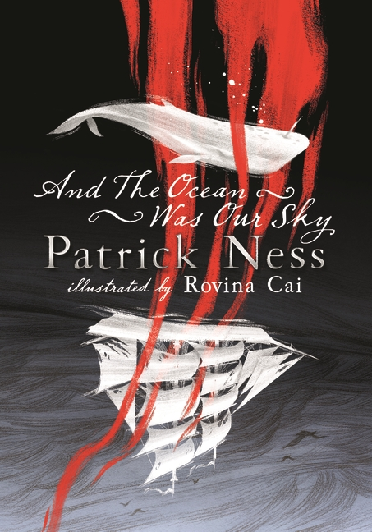
Seasonal Survival
Fireside Feasts
The California drought has become a fact of life – annoying but bearable - until one day the taps run dry, forcing a teenager to make life or death decisions for their family.
Evan Hansen has been given the chance of a lifetime. The only catch is, he has to maintain the lie he never meant to tell…
Festive Fantasy
Seasonal Science Fiction
Magic can turn tides, light the darkness and bring back the dead. But magic is gone– until one girl sets out to bring it back. The first book in a new epic-fantasy sequence.
Ten teenagers are headed for a distant planet where they’ll hunt for Nyxia, the most extraordinary substance in the universe. If they survive the trip…

